Slide 1
Introduction to Rhetorical Appeals

Slide 2
What do we mean by Rhetoric?
Rhetoric – is the art of persuasive speaking or writing
the art of convincing an audience that it should listen to, and be persuaded by, the author’s argument through the arrangement, delivery, and style of his/her message.

Slide 3
Why do we care?
Rhetoric allows you to…
Read, write, think, and live more critically.
Fully participate as a global citizen.
Turn words into actions.

Slide 4
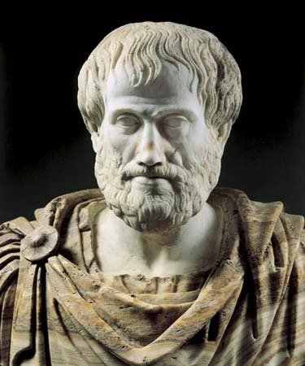
Who can we thank for giving us rhetoric?
Aristotle, an ancient Greek philosopher

Slide 5
The Rhetorical Appeals: The Means of Persuasion
Ethos
Logos
Pathos

Slide 6
Ethos
Definition: the speaker establishes credibility/trustworthiness
How to…
Demonstrate knowledge, experience, or expertise
Establish common ground or relatability with the audience
Demonstrate fairness

Slide 7
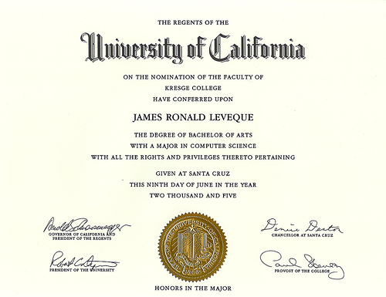
Ethos Examples
Professional Degree/Recognition
Years of Experience
Common Ground
https://www.youtube.com/watch?v=SviQfBuA9c0

Slide 8
Logos
Definition: the speaker appeals to the
audience’s sense of logic.
How to…
Provide examples, facts, or statistics
Include Expert Testimonies
Establish cause and effect

Slide 9
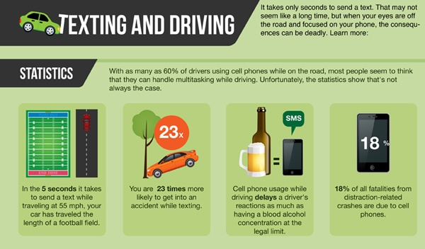
Logos Examples
Percentages/Amounts
Real Examples
Expert Insight
“According to…”
https://www.youtube.com/watch?v=tXqAyMhgc7I

Slide 10
Pathos
Definition: the speaker appeals to the
emotions of the audience.
How to…
Use descriptive language
Use figurative language (simile, metaphor, etc.)
Share personal/real anecdotes (stories)
Use word choice that makes people feel something (Connotation/Loaded Words)

Slide 11
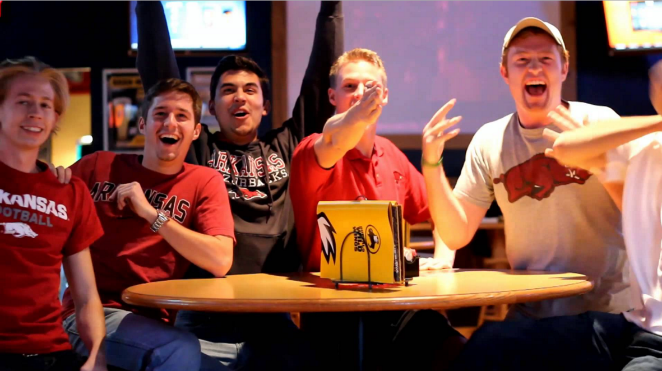
Pathos Examples
Evoking strong emotion in your audience: joy, excitement, fear, sadness, jealousy, etc.
https://www.youtube.com/watch?v=HypgcCT1r68

Slide 12
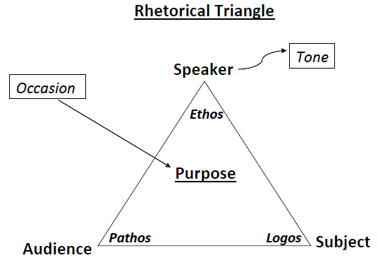

Slide 13
Practicing Appeals
Please identify…
ETHOS? LOGOS? OR PATHOS?

Slide 14
Practicing Appeals
1. According to the U.S. Bureau of Labor Statistics, “about half of all new establishments survive five years or more and about one-third survive 10 years or more. As one would expect, the probability of survival increases with a firm’s age. Survival rates have changed little over time.”

Slide 15
Practicing Appeals
2. A small puppy in a cage comes into view. The camera pans around into the dark, narrow space that confines the cage and its captive. The camera zooms back to the puppy’s large, sorrowful eyes, which wince in slow-motion. Text fades onto the screen, “Adopt an Animal Today.”

Slide 16
Practicing Appeals
3. Brian’s power-washing company has been serving clients in the Greater Philadelphia Area for over 25 years!

Slide 17
Practicing Appeals
4. According to Statista, in 2015, [McDonald’s] not only had 14,259 restaurants in the United States, but a further 22,266 in international locations.

Slide 18
Practicing Appeals
5. Imagine what it would be like as a nine-year old boy, who is afraid to go to school because of the way other kids treat you. Every hallway. Every classroom. Every corner. There is no where to hide from the comments, from the shoving, from the pain. Yes, a building full of people..but you feel as if no one is there to support you. Imagine that.

Slide 19
Practicing Appeals
6. My friends at my school recommended the new restaurant in Valley Square. We usually enjoy the same kind of food and service, so I think I’ll try it out!

Slide 20
Practicing Appeals
7. C.B. South High School stands out because it provides a diverse options for extracurricular activities. For instance, one could join anything from the swim team to mock trial to Great Films club. There are SO many options!

Slide 21
Practicing Appeals
8. According to National Geographic, “since 1959, Florida has had more shark attacks (603) than lightning fatalities (459).”

